Slide 1

Artificial Intelligence
Hand Gesture Recognition
Hélène, Alexander, Dennis

Slide 2
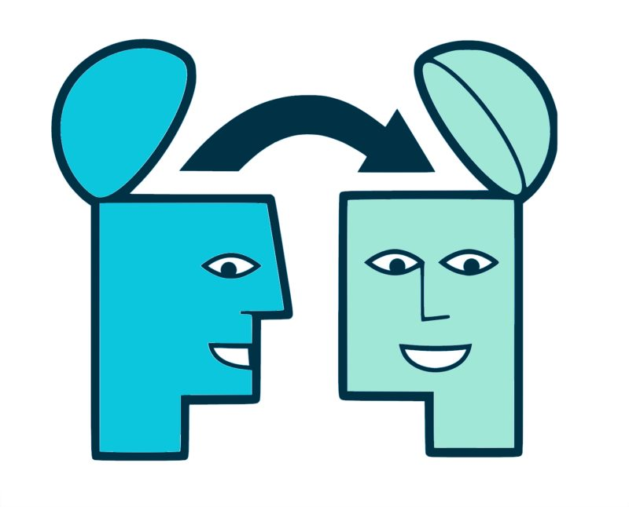
Objectives
Apply the concept of Transfer Learning to resolve an image classification problem
Adapt pre designed Convolutional Neural Networks architectures to our dataset
Fine Tune each model with our dataset
Compare between different Convolutional Neural Networks architectures

Slide 3
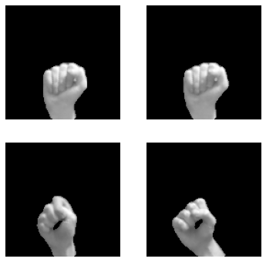
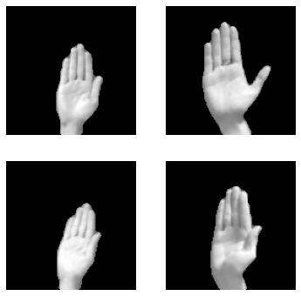
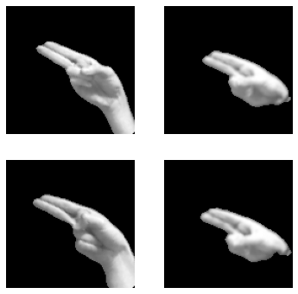
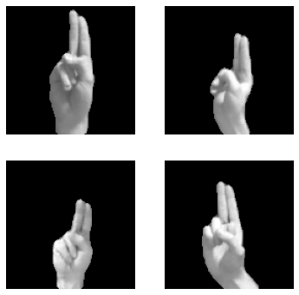
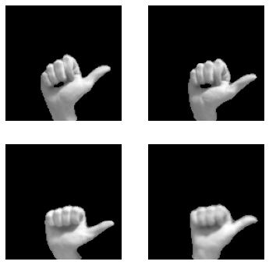
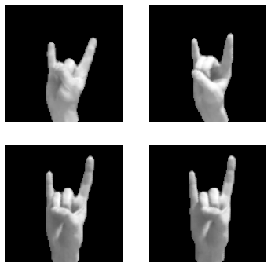
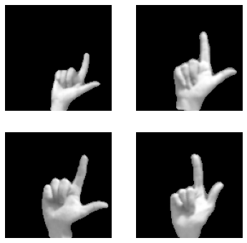
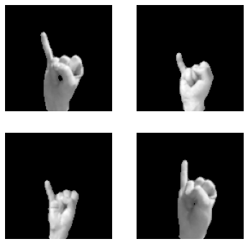
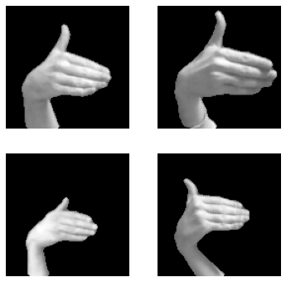
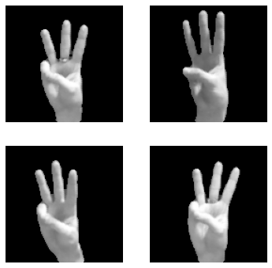
Our dataset (10 classes)
CLASS 0
CLASS 1
CLASS 2
CLASS 3
CLASS 4
CLASS 5
CLASS 6
CLASS 7
CLASS 8
CLASS 9

Slide 4
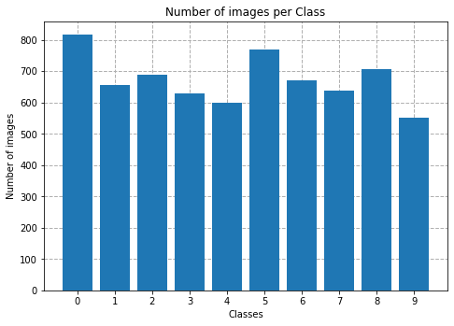
Number of images per class
For all our models:
5381 images for training (~80%)
1346 images for testing (~20%)

Slide 5
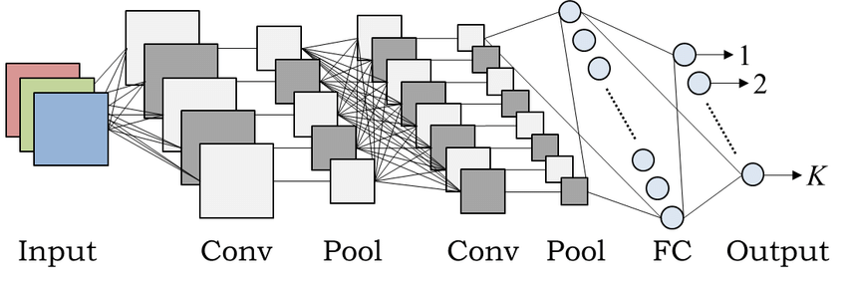
Adaptation of each model
The only thing we changed on each architecture is the last layer.
We changed the last layer for a linear layer with 10 outputs (because we have 10 classes)
We trained all models for 15 epochs with Cross Entropy loss function

Slide 6
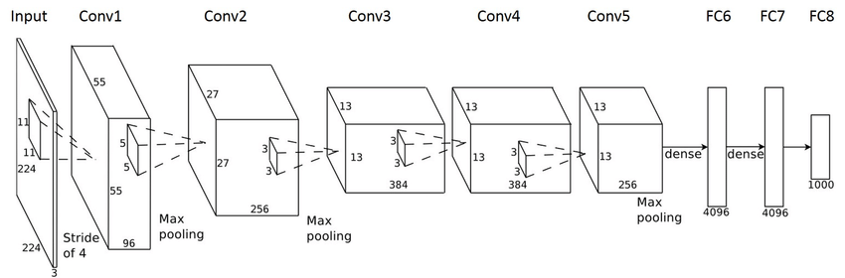
Transfer-learning using AlexNet
ImageNet
The training data, containing the 1000 categories and 1.2 million images
https://arxiv.org/abs/1404.5997

Slide 7
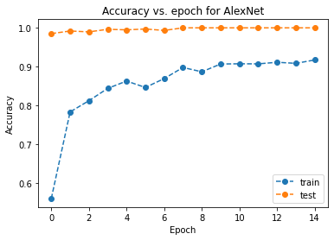
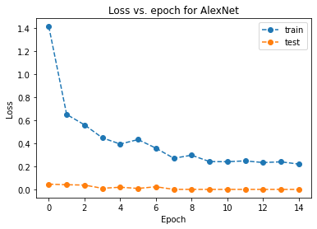
Transfer-learning using AlexNet

Slide 8
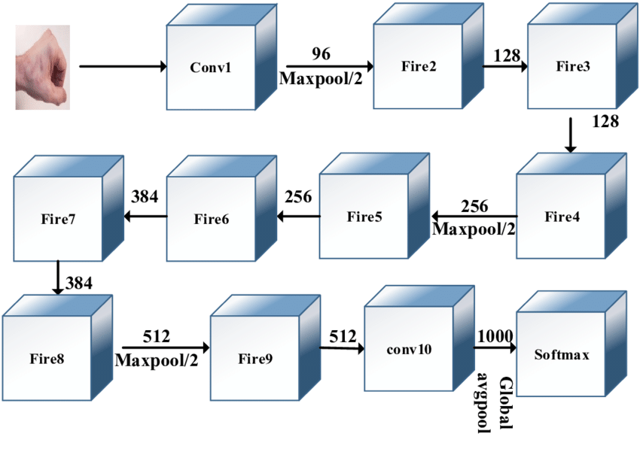
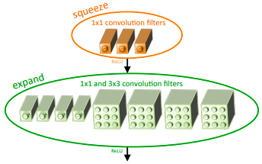
Transfer-learning using SqueezeNet
ImageNet
The training data, containing the 1000 categories and 1.2 million images
https://arxiv.org/abs/1602.07360

Slide 9
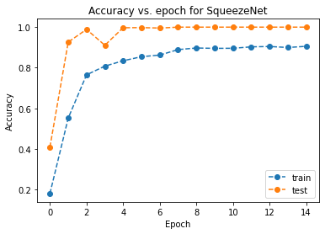
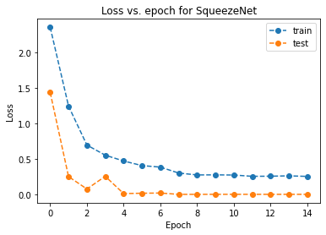
Transfer-learning using SqueezeNet

Slide 10
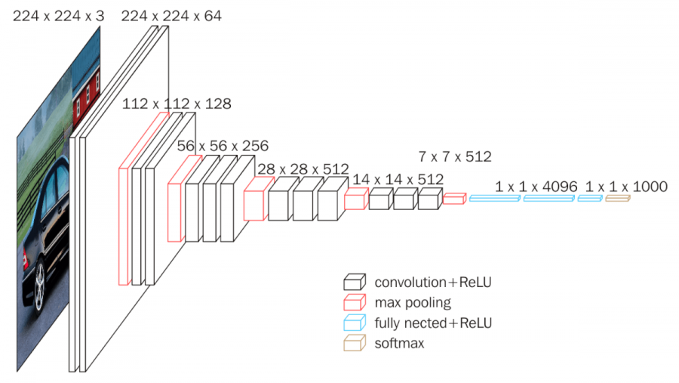
Transfer-learning using VGG16
ImageNet
The training data, containing the 1000 categories and 1.2 million images
https://arxiv.org/abs/1409.1556

Slide 11
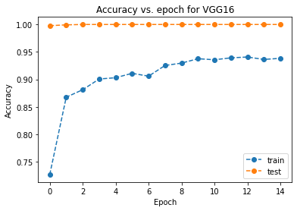
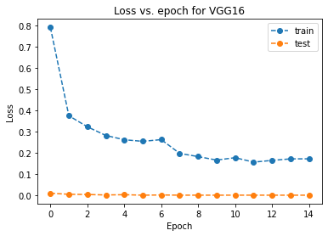
Transfer-learning using VGG16

Slide 12
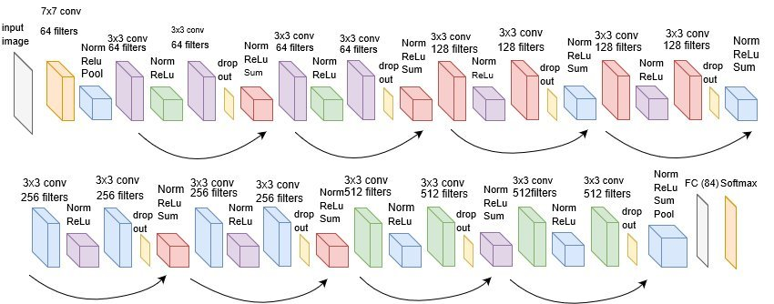
ImageNet
Transfer-learning using ResNet
The training data, containing the 1000 categories and 1.2 million images
https://arxiv.org/abs/1512.03385

Slide 13
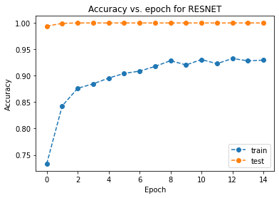
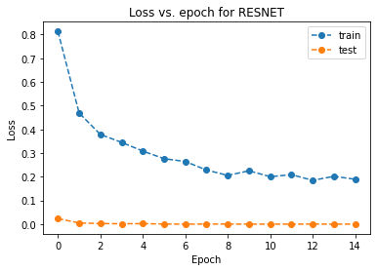
Transfer-learning using ResNet

Slide 14
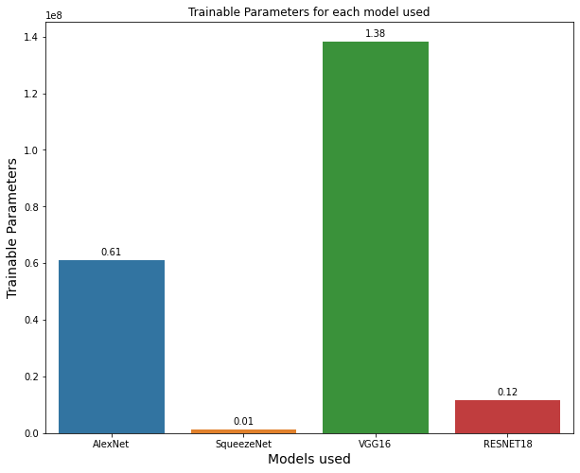
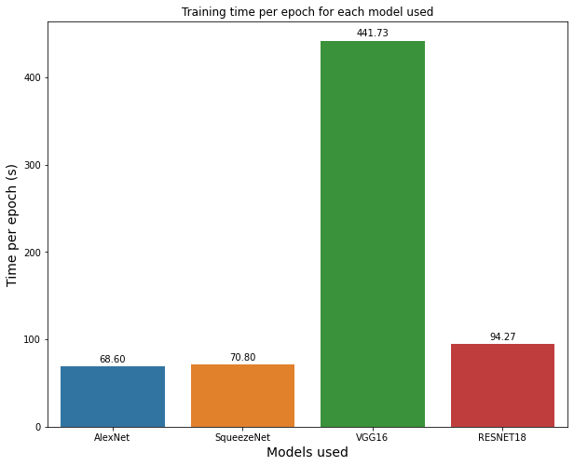
Comparison between the models

Slide 15
Conclusion
All models employed achieved a 100% accuracy in test set (probably because our dataset was clean and clear)
Models were to complex for our dataset
We got lower performance in training dataset because probably “harder” examples were there but not in test
VGG16 was the most complex model used, with 138,357,544 trainable parameters!
For our problem, using a simpler Neural Network model would probably be enough

